Slide 1
Project On Google Play Store Data Analysis
By subhashree rameshkumar

Slide 2
Outline
Problem statement
Data overview
Pre processing
Data analysis
Conclusion

Slide 3

Problem statement
App Monetization

Slide 4


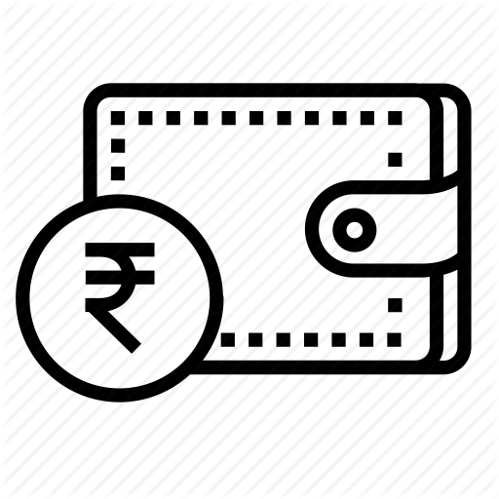



Data overview
5. Price
1. Installs
4. Rating
2. Category of apps
3. Type

Slide 5
Pre- processing
Removal of wrong values
Filling of null values based to category and mean
Removal of characters like (+ and , ) from Installs column
Removal of ($) symbol from the price column

Slide 6

2. Category of apps
3. Type
5. Price
1. Installs
4. Rating
What are my target app’s that will earn profit ?
Which category of app’s has most number of installs?
Does the customer prefer free or paid app?
Which are the app’s which are most installed in free type ?
What is the rating given in free type ?
If upselling a product was a option then ,which are the app’s that customer is ready to pay?, how much is the customer ready to pay?

Slide 7
1.What are my target app’s that will earn profit ?
Installs needs to be high in order
to align towards my target App

Slide 8
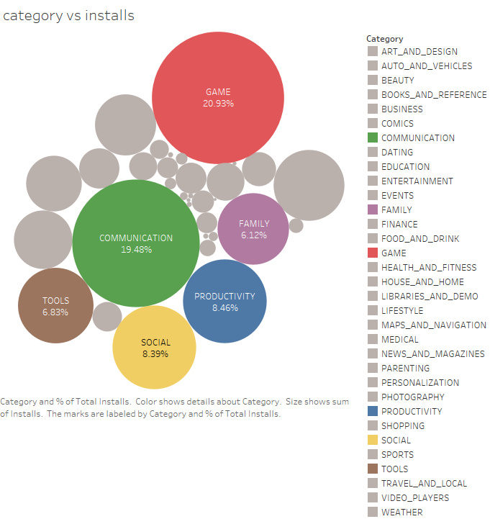
Which category of app’s has most number of installs?
Category | Percentage of total
Game | 20.93 %
Communication | 19.48 %
Productivity | 8.46 %
Social | 8.39 %
Tools | 6.38%
Family | 6.12 %
SUM | 70 %

Slide 9
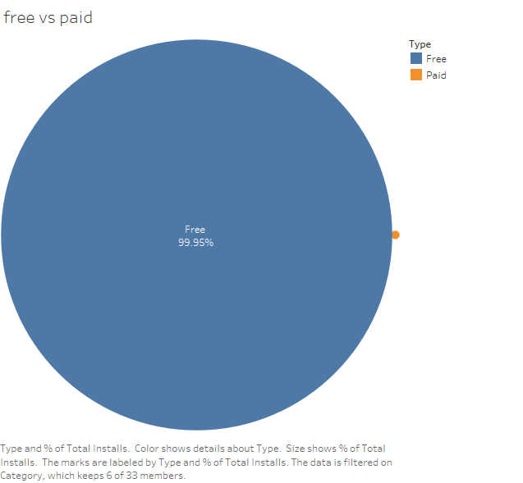
3.Does the customer prefer free or paid app?
Type | Percentage total
Free | 99.95%
Paid | 0.05%

Slide 10
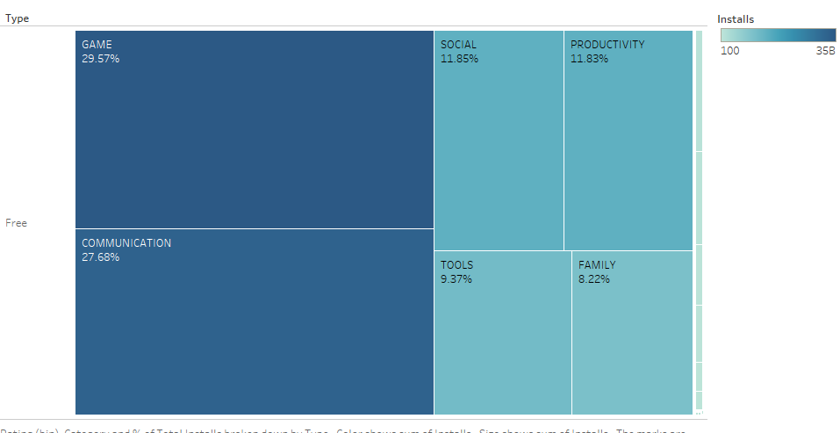
4. Which are the app’s that are most installed in free type ?

Slide 11
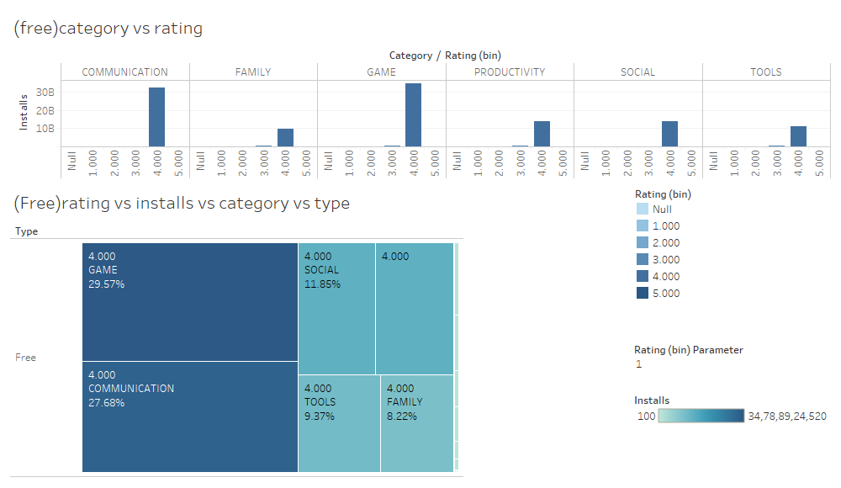
5. What is the rating given in free type ?

Slide 12
6.If upselling a product was a option then ,which are the apps that customer is ready to pay?, how much is the customer ready to pay?
Refer:
https://public.tableau.com/profile/subhashree2398#!/vizhome/Book4_15554846891370/Story1?publish=yes

Slide 13
Conclusion
Rank | Category | Upsell | Cost
1. | Game | Yes | 3.5 $
2. | Communication | No | ______
3. | Social | No | ______
4. | Productivity | No | ______
5. | Tools | No | ______
6. | Family | Yes | 3.25 $

